Slide 1
CRAFT’S DEMO
BY SIDDHANT GAUTAM

Slide 2
AGENDA
Introduction
Requirement
Assumptions
Flow Diagram
Entity Details
Class Diagram
Design Pattern Used
Algorithm
Demo and Code Walkthrough
Further Enhancements

Slide 3
INTRODUCTION
Title : SDE 2 @Nuclei
4+ years building robust backend systems.
Leading the pack as Backend Team Lead at Nuclei, a fintech startup.
Powering mobile banking by developing the backend for FedMobile, the official app for Federal Bank, creating UPI services
Tech stack: Java, Spring Boot, Microservices, REST APIs, Docker, Kubernetes, OpenShift.
Previous Experience: Experienced in Python and Django development.
Fun Fact: Analytical thinker with a passion for efficiency (and chess!).

Slide 4
REQUIREMENT
This project is part of a gaming service responsible for tracking all-time top scores. As players
complete a game, the game service publishes the player's score to a Kafka topic (or a flat file).
This service processes these scores and maintains a leaderboard, returning the top 5 scores and the
corresponding player names upon request.

Slide 5
ASSUMPTIONS
Player and Score Validation: The gaming service guarantees that all published scores belong to either registered or valid guest users. No further verification of player identity or score integrity is necessary.
Player Ranking: In case of identical scores, player positions on the leaderboard are determined by reverse lexicographical order of their unique usernames.
Data Consistency: Player data is updated sequentially, preventing concurrent modifications from the same player.
Score Structure: Scores are represented as simple numerical values. The leaderboard displays the top N scores along with their corresponding usernames, where N is a configurable parameter.
Internal API Usage: All APIs are exclusively used within the gaming service ecosystem
Leaderboard Structure: Currently, a single leaderboard is maintained. The system is designed to accommodate multiple leaderboards in future expansions.
Scalability: The current system efficiently handles the present workload on a single server. Additional servers can be integrated to accommodate increased traffic.

Slide 6
FLOW/USAGE
Admins can create and register a leaderboard. During creation, any existing internal data in the datastore is processed.
Upon registration, a leaderboard becomes immediately ready to receive scores.
The score service ingests player scores into both a leaderboard(cache) and persistent storage (database).
Leaderboards are updated as soon as scores are ingested after a game concludes.
Top N player score details can be retrieved at any time after leaderboard registration.

Slide 7
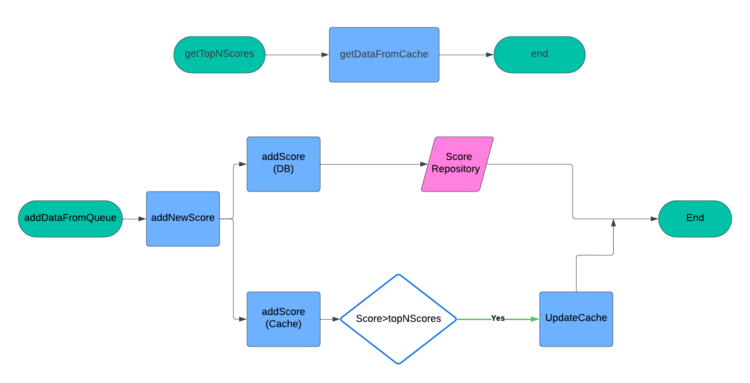
FLOW DIAGRAM

Slide 8
ENTITY DETAILS
player_id : Id of each player and will be unique
player_name : Name of the player
score : score of the player in a game

Slide 9
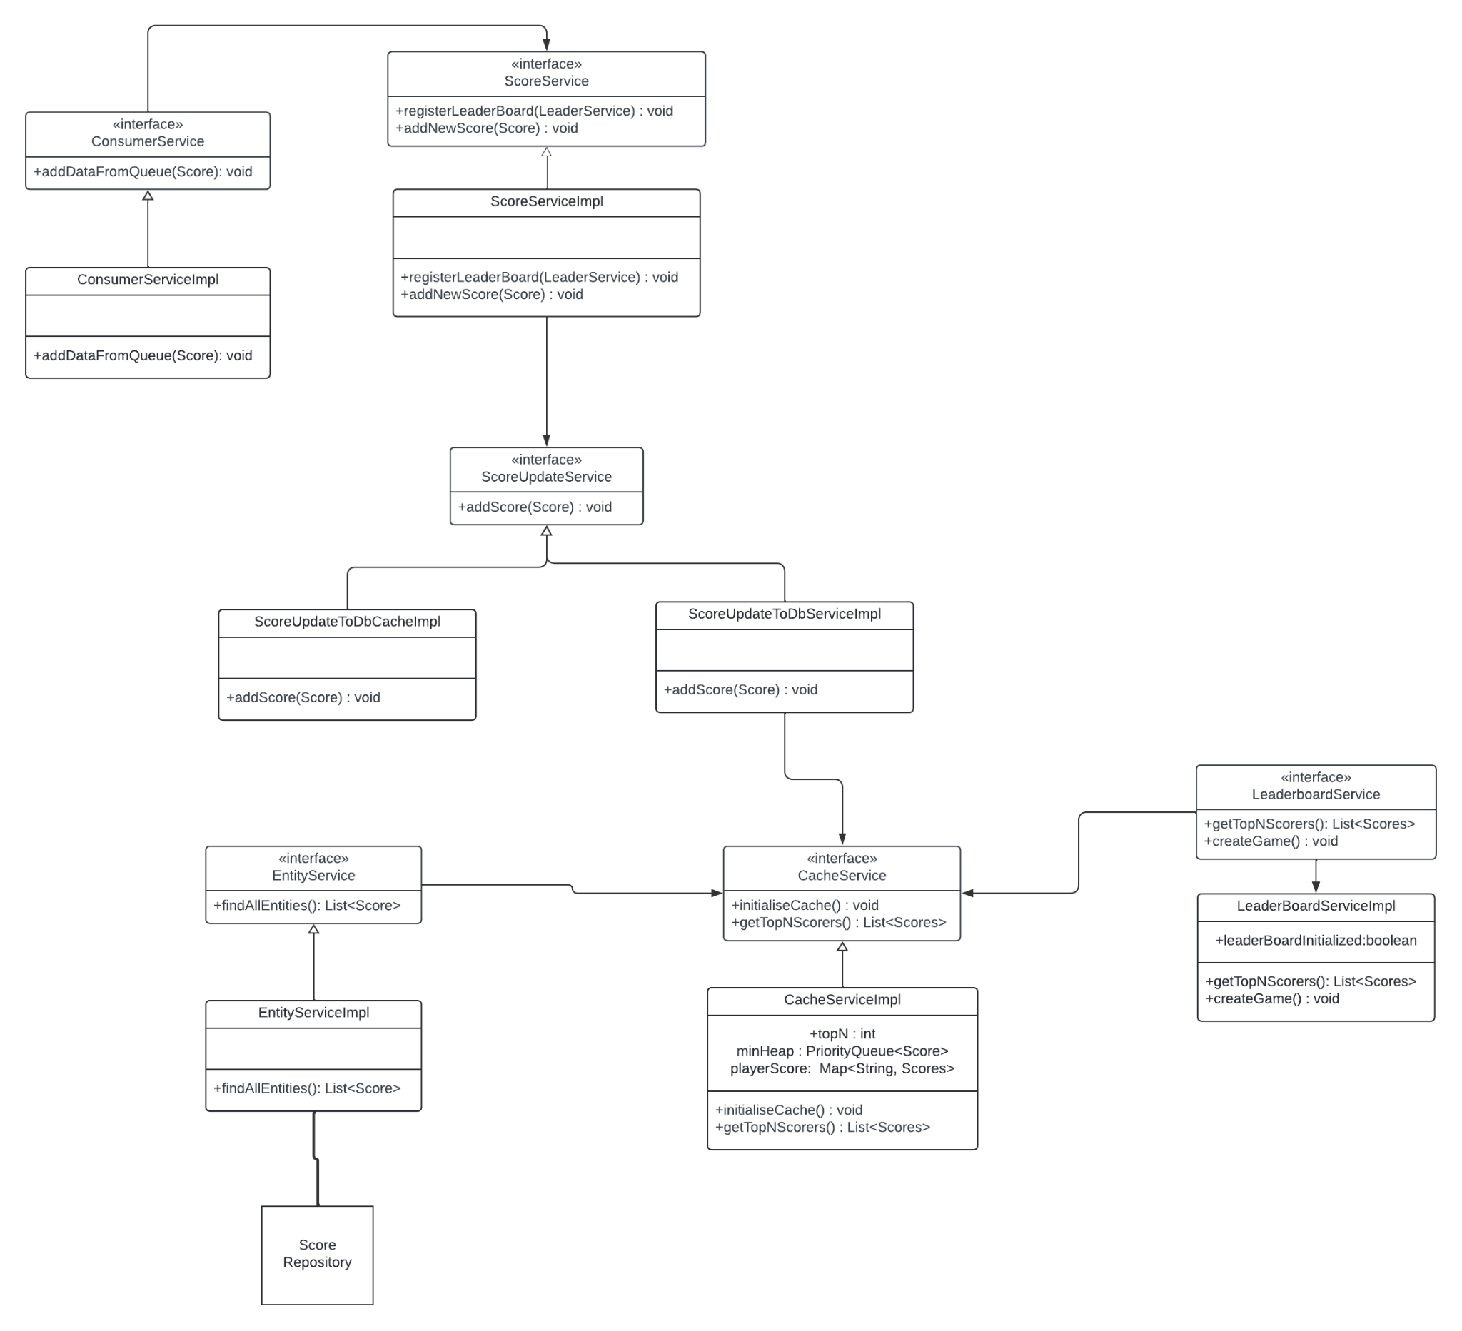
CLASS DIAGRAM

Slide 10
DESIGN PATTERN USED
Observer Design Pattern : LeaderBoard uses observer design pattern
Strategy Design Pattern : While updating data in db and cache we are using strategy design pattern

Slide 11
ALGORITHM USED
For cache we are using Min Heap and maintaining a HashMap
To maintain the top K score we are using Min Heap
While updating the leaderboard, we check and compare if the score for the player that is being updated is already present in the Min Heap or not. If the player is already on the leaderboard and the new score is greater than the present score, we update the rank else we ignore.
Time Complexity : O(NlogK) to create the Heap.
Space Complexity: O(K)

Slide 12
DEMO AND CODE WALKTHROUGH

Slide 13
FURTHER ENHANCEMENTS
Authentication for admin while creating a game can be added
For cache, redis can be used for distributed cache system which can be helpful while maintaining multiple top K.
Architecture can be broken down from monolith to microservice architecture for a more robust service

Slide 14
QUESTIONS

Slide 15
REFERENCES
https://serhatgiydiren.com/system-design-interview-top-k-problem-heavy-hitters/
https://aws.amazon.com/blogs/database/building-a-real-time-gaming-leaderboard-with-amazon-elasticache-for-redis/
https://algo.monster/liteproblems/347

